Slide 1
Control System Theory Block Diagram Reduction
https://youtube.com/playlist?list=PLBlnK6fEyqRineUwP-HPdkQvowXqq5IxA&si=1dXffwOVbx4EpPoL

Slide 2
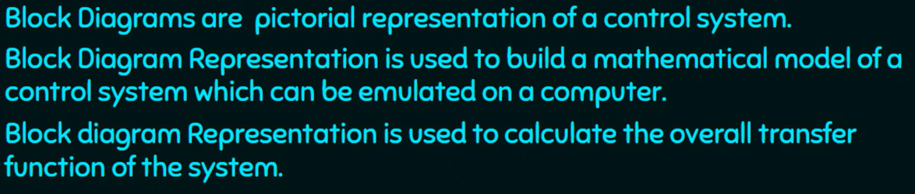
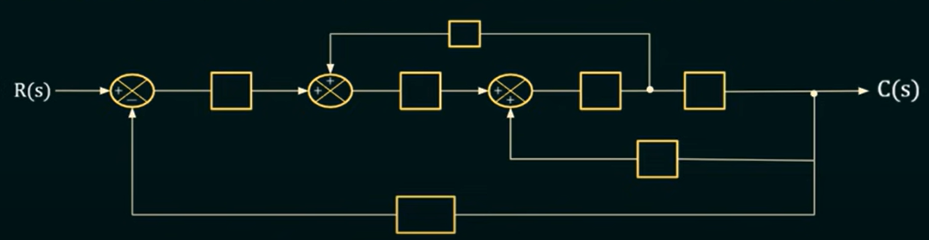
Block Diagrams

Slide 3
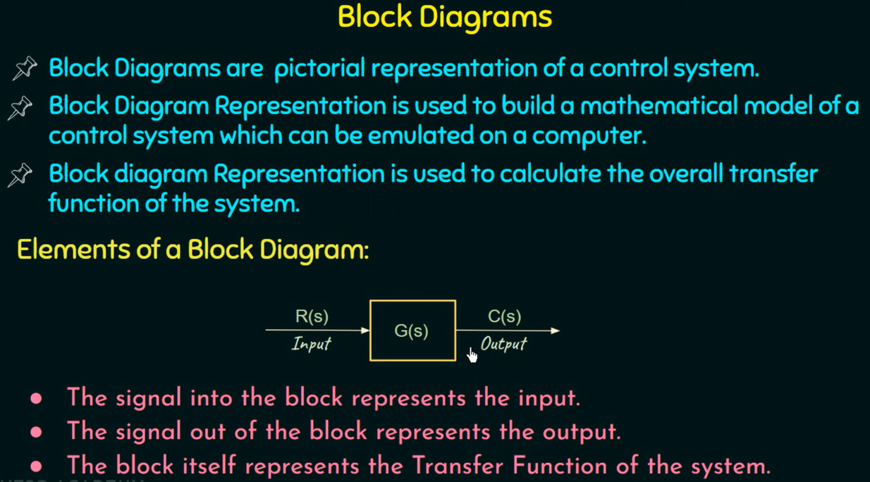

Slide 4
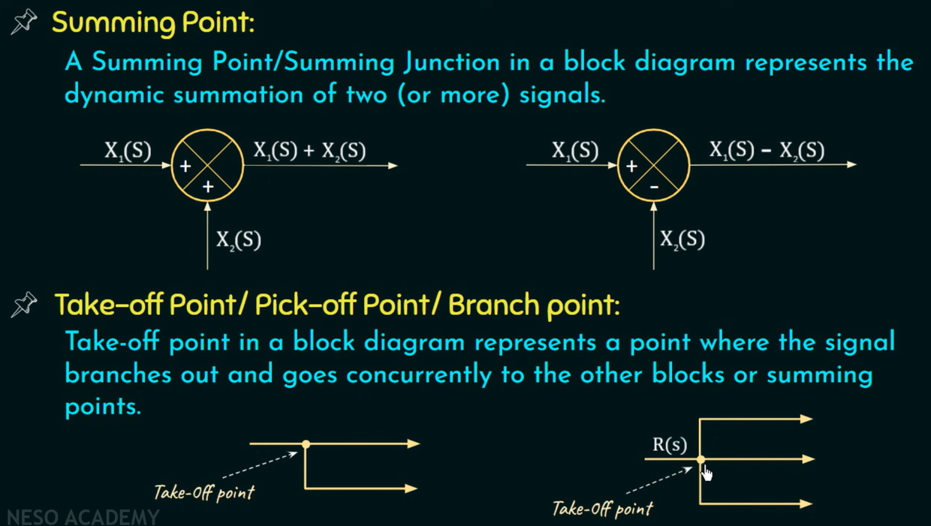

Slide 5
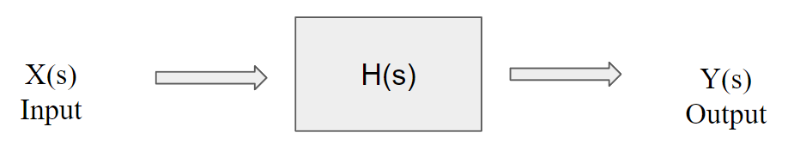
Block Diagram Reduction rule

Slide 6
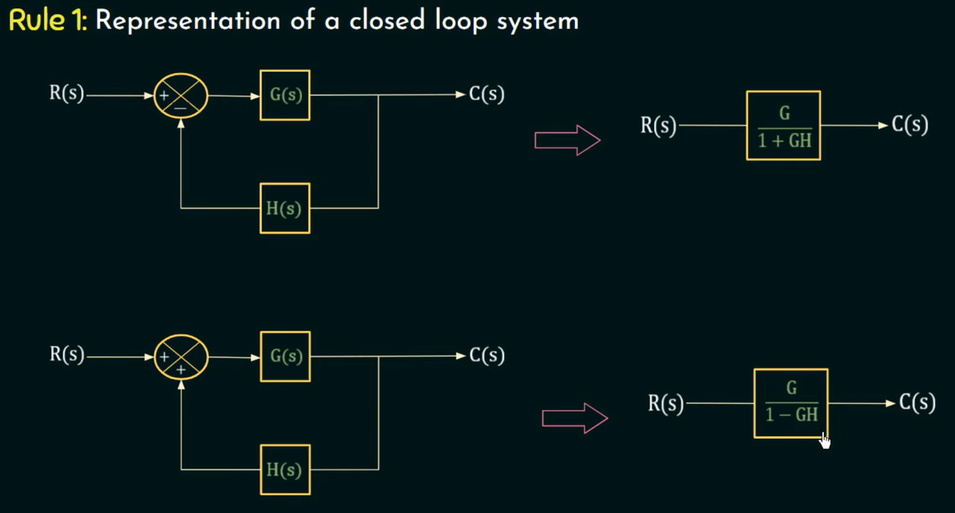

Slide 7
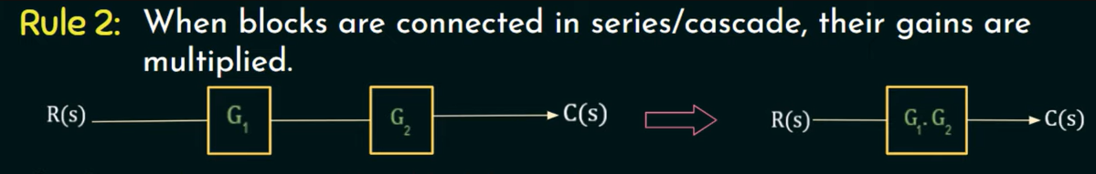
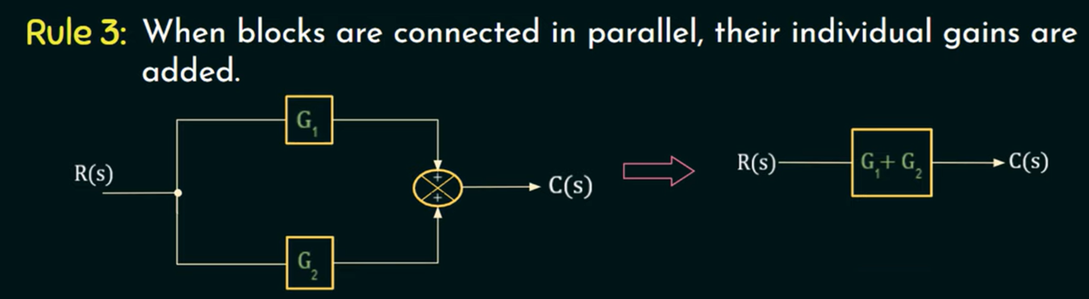

Slide 8
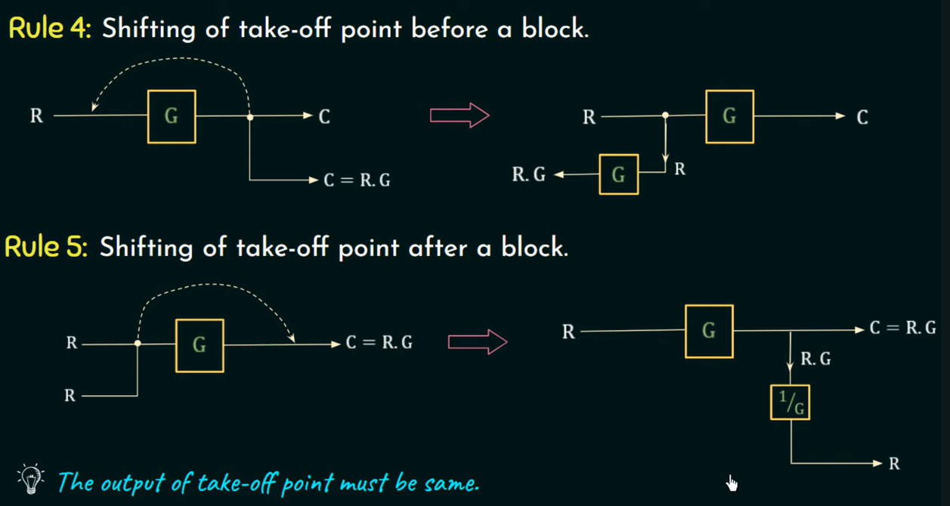

Slide 9
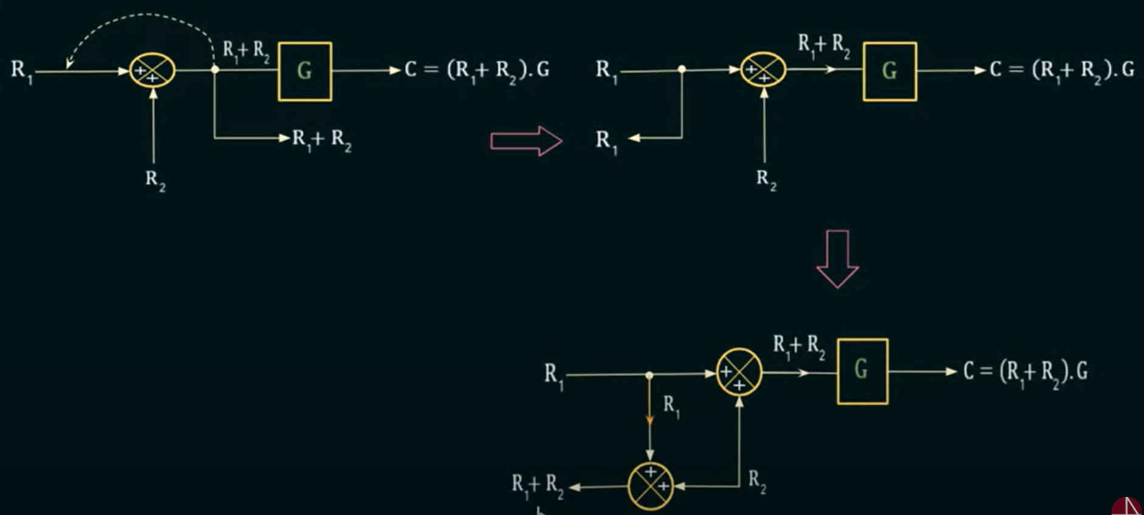
Rule 6 : Shifting take-off before an adder

Slide 10
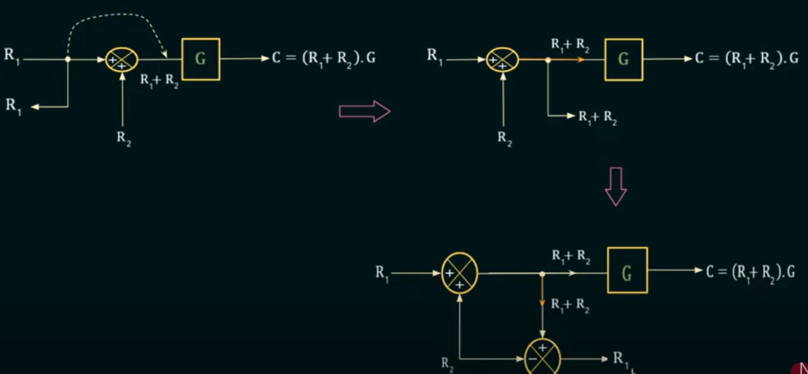
Rule 7: Shifting take-off after an adder

Slide 11
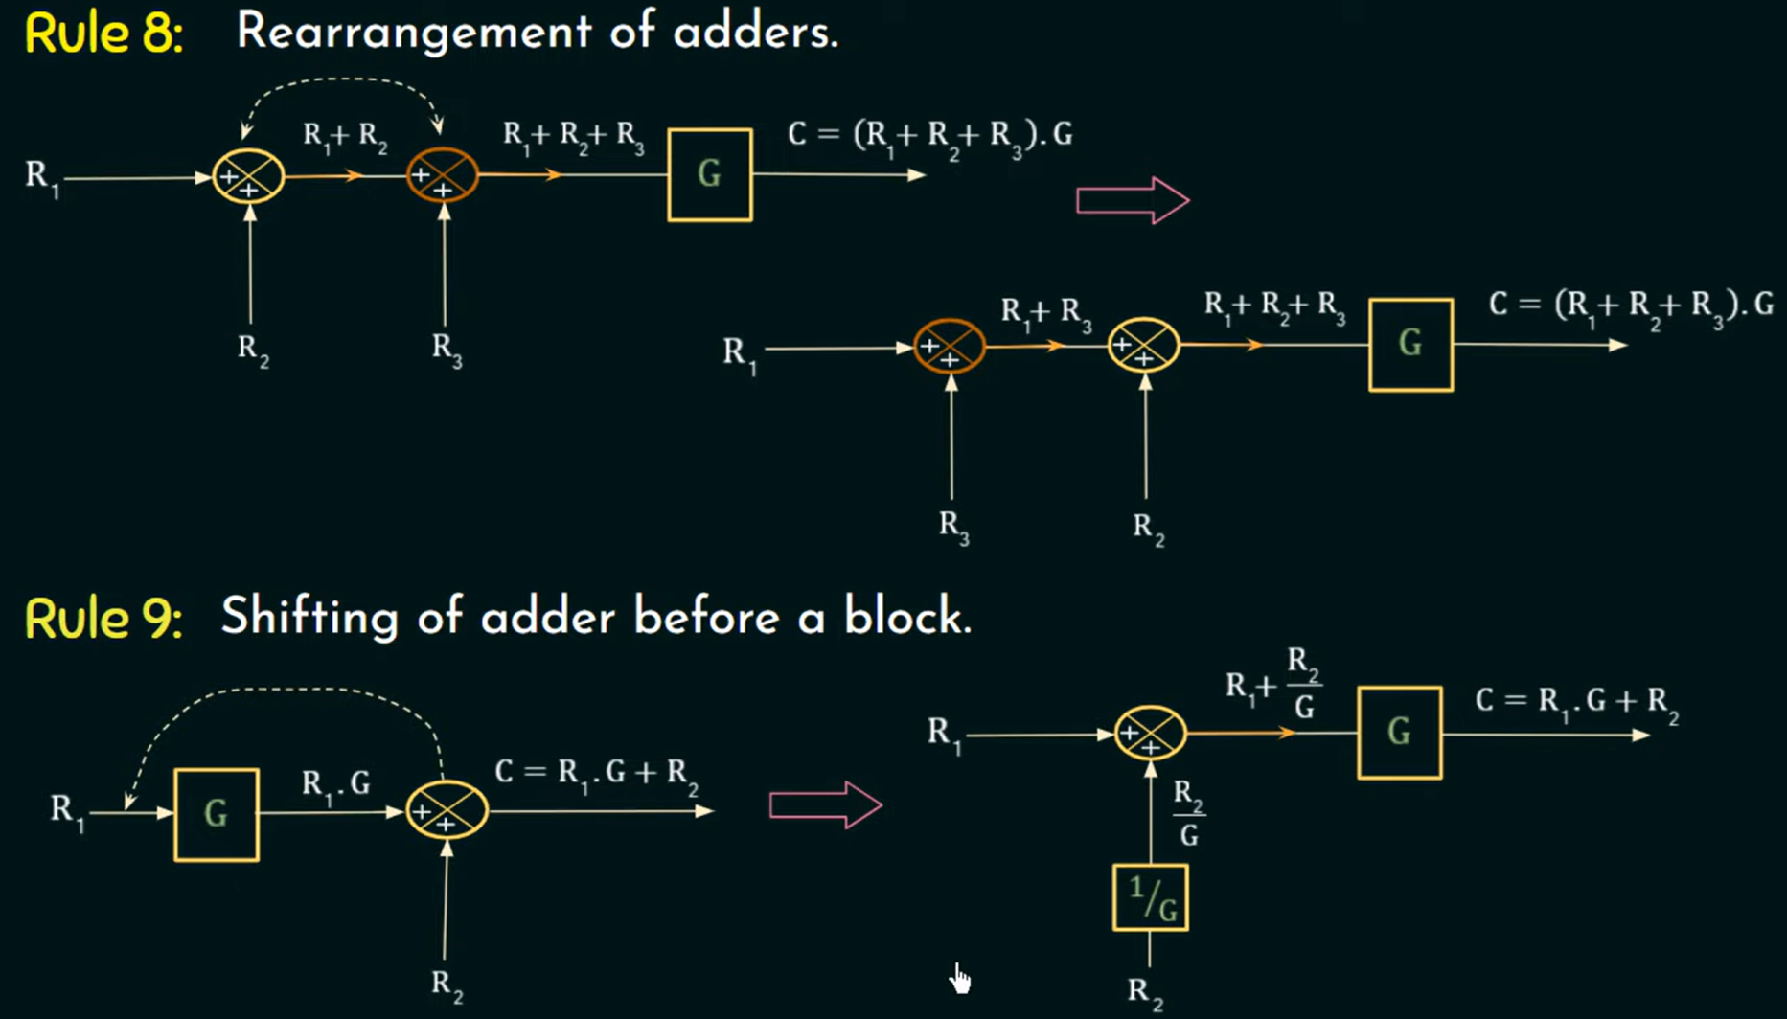

Slide 12
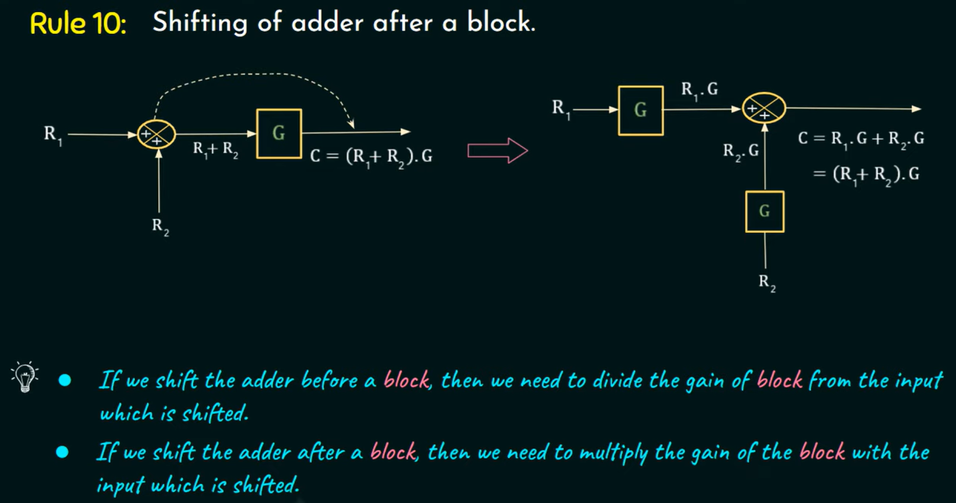

Slide 13
Block Diagram Reduction Algorithm
Rule 1 − Check for the blocks connected in series and simplify.
Rule 2 − Check for the blocks connected in parallel and simplify.
Rule 3 − Check for the blocks connected in feedback loop and simplify.
Rule 4 − If there is difficulty with take-off point while simplifying, shift it towards right/left.
Rule 5 − If there is difficulty with summing point while simplifying, shift it towards right/left.
Rule 6 − Repeat the above steps till you get the simplified form, i.e., single block.

Slide 14
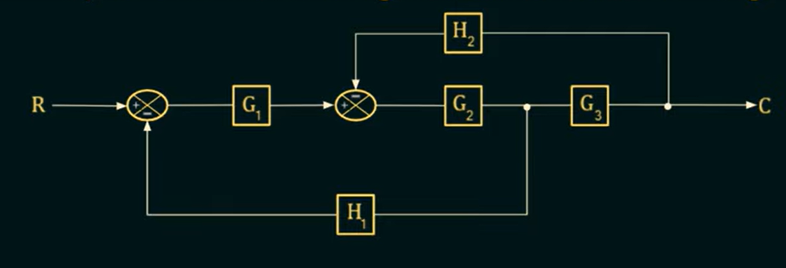
Problem 1:
Rule 1 − Check for the blocks connected in series and simplify.
Rule 2 − Check for the blocks connected in parallel and simplify.
Rule 3 − Check for the blocks connected in feedback loop and simplify.
Rule 4 − If there is difficulty with take-off point while simplifying, shift it towards right/left.
Rule 5 − If there is difficulty with summing point while simplifying, shift it towards right/left.
Rule 6 − Repeat the above steps till you get the simplified form, i.e., single block.

Slide 15
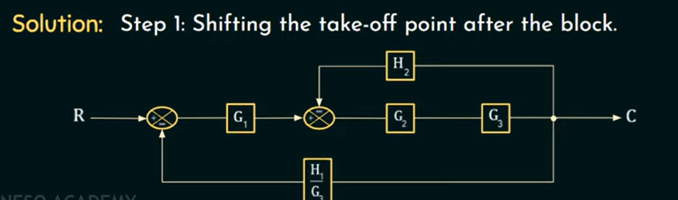
Rule 1 − Check for the blocks connected in series and simplify.
Rule 2 − Check for the blocks connected in parallel and simplify.
Rule 3 − Check for the blocks connected in feedback loop and simplify.
Rule 4 − If there is difficulty with take-off point while simplifying, shift it towards right/left.
Rule 5 − If there is difficulty with summing point while simplifying, shift it towards right/left.
Rule 6 − Repeat the above steps till you get the simplified form, i.e., single block.

Slide 16
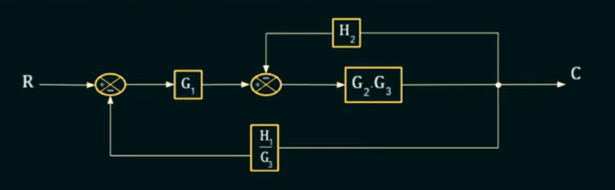
Rule 1 − Check for the blocks connected in series and simplify.
Rule 2 − Check for the blocks connected in parallel and simplify.
Rule 3 − Check for the blocks connected in feedback loop and simplify.
Rule 4 − If there is difficulty with take-off point while simplifying, shift it towards right/left.
Rule 5 − If there is difficulty with summing point while simplifying, shift it towards right/left.
Rule 6 − Repeat the above steps till you get the simplified form, i.e., single block.

Slide 17
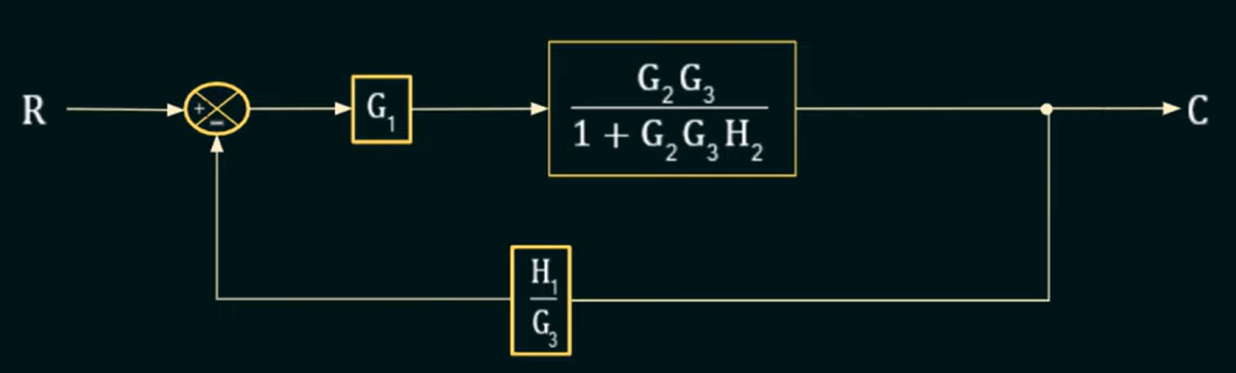
Rule 1 − Check for the blocks connected in series and simplify.
Rule 2 − Check for the blocks connected in parallel and simplify.
Rule 3 − Check for the blocks connected in feedback loop and simplify.
Rule 4 − If there is difficulty with take-off point while simplifying, shift it towards right/left.
Rule 5 − If there is difficulty with summing point while simplifying, shift it towards right/left.
Rule 6 − Repeat the above steps till you get the simplified form, i.e., single block.

Slide 18
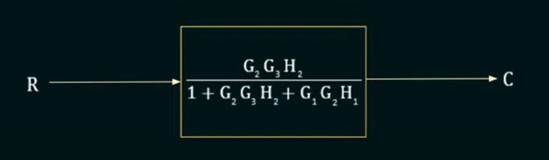


Rule 1 − Check for the blocks connected in series and simplify.
Rule 2 − Check for the blocks connected in parallel and simplify.
Rule 3 − Check for the blocks connected in feedback loop and simplify.
Rule 4 − If there is difficulty with take-off point while simplifying, shift it towards right.
Rule 5 − If there is difficulty with summing point while simplifying, shift it towards left.
Rule 6 − Repeat the above steps till you get the simplified form, i.e., single block.

Slide 19
Rule 1 − Check for the blocks connected in series and simplify.
Rule 2 − Check for the blocks connected in parallel and simplify.
Rule 3 − Check for the blocks connected in feedback loop and simplify.
Rule 4 − If there is difficulty with take-off point while simplifying, shift it towards right.
Rule 5 − If there is difficulty with summing point while simplifying, shift it towards left.
Rule 6 − Repeat the above steps till you get the simplified form, i.e., single block.
Result

Slide 20
Practice for Home

Slide 21
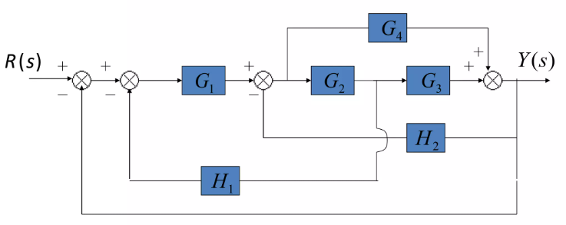
Problem 1

Slide 22
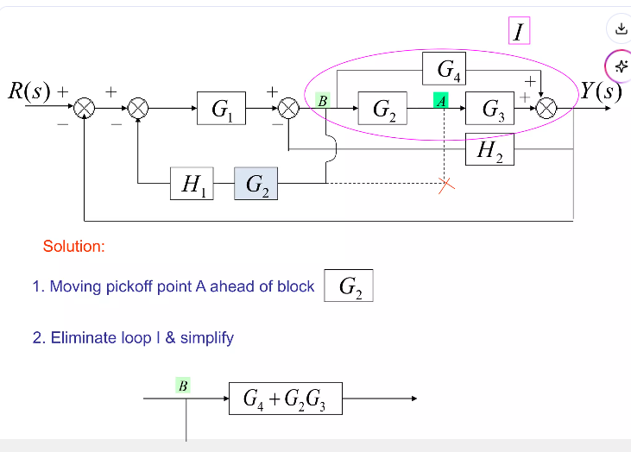

Slide 23
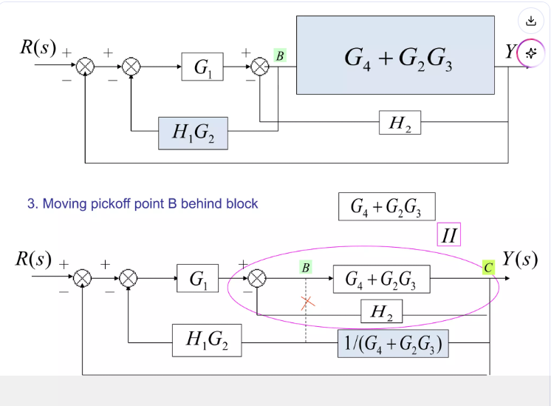

Slide 24
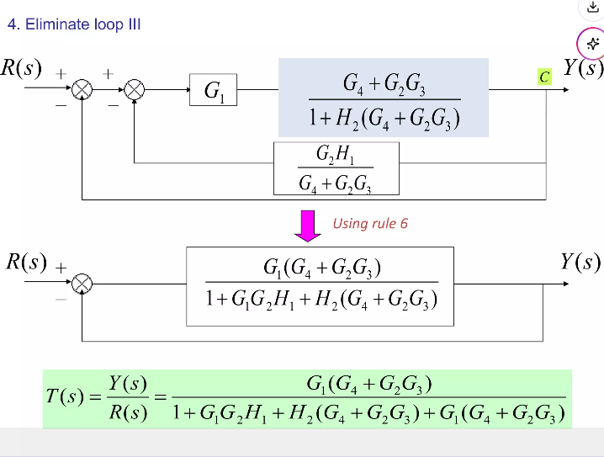

Slide 25
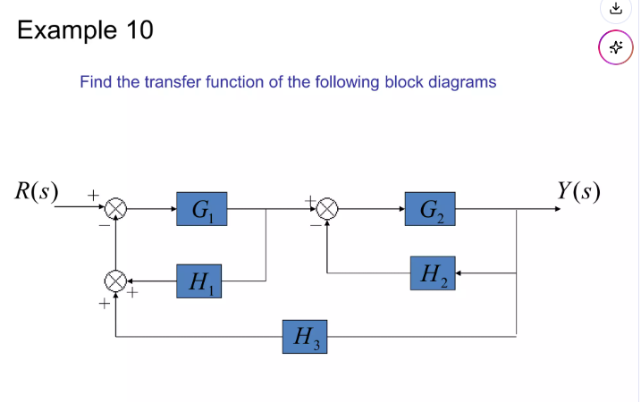
Problem 2

Slide 26
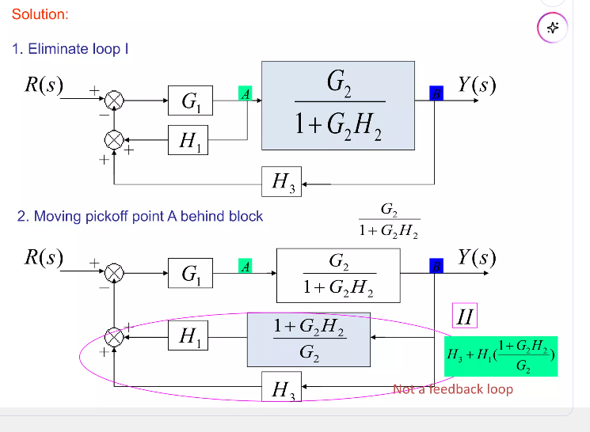

Slide 27
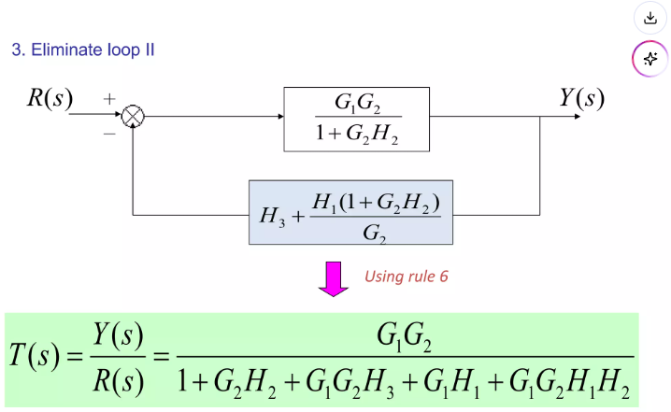

Slide 28
Next Class
PID Control

Slide 29
Thank You

